Slide 1
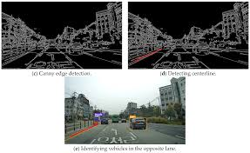
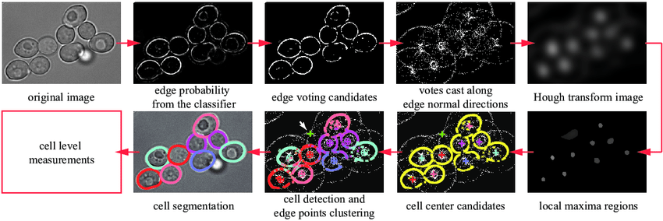
Quantum Hadamard Edge Detection(QHED)
Edge detection is a fundamental skills in image processing.
E.g. Detection of the edges of cancer cells,
edges of lanes and cars in automatic vehicles
As the resolution of images increases, classical algorithm becomes slow in edge detection

Slide 2
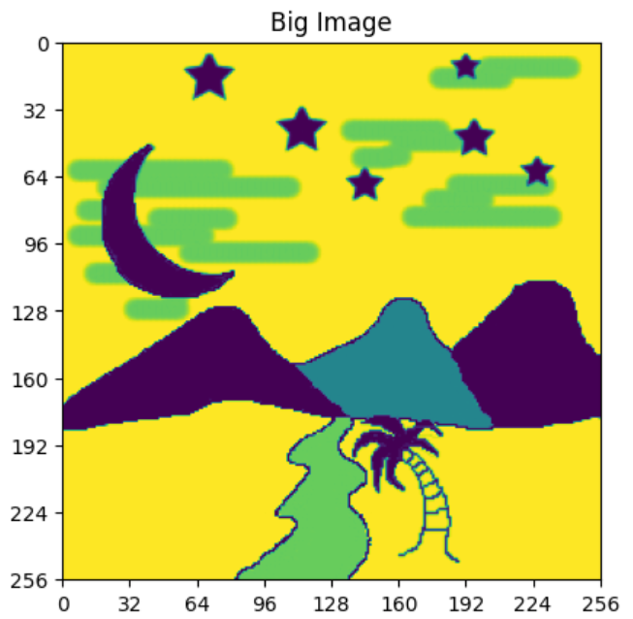
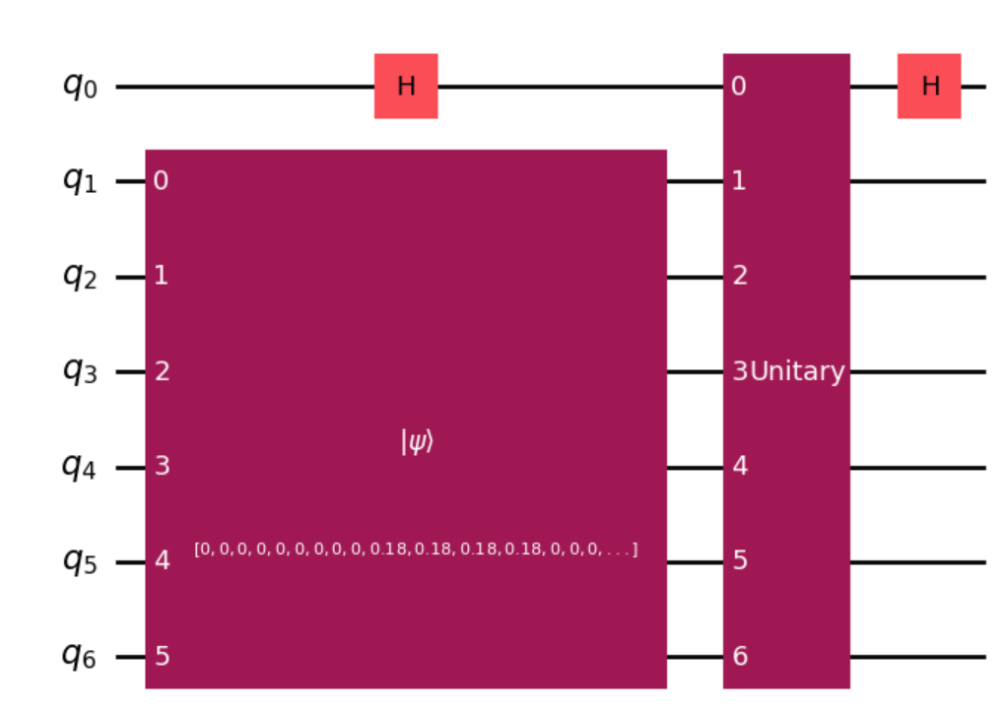
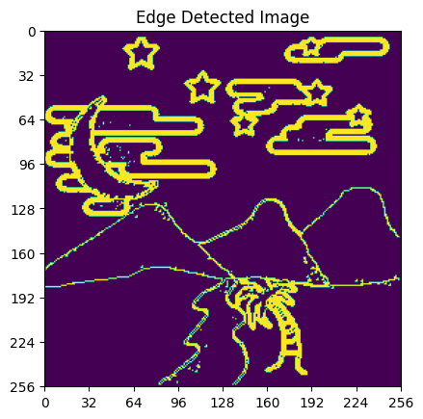
Quantum Hadamard Edge Detection(QHED)
In this projects, one will learn how QHED have the potential to speed up Edge Detection
Goals:
Understand the time complexity of QHED vs classical method
Implement QHED using Qiskits
Find your own images/ Design your own edge detection algorithm e.g. adapt to arbitrary image size/ multiple color channels
QHED

